Slide 1
Session 2 Sampling
Prof Vishnuprasad Nagadevara
Nagadevara_V@isb.edu

Slide 2
Learning objectives
What is statistical inference?
How to (and how not to) choose a sample?
What are sample statistics and their properties?
What is the central limit theorem and how is it useful?

Slide 3
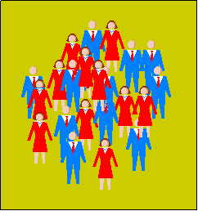
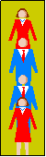
Statistical Inference
Statistical Inference
Drawing conclusions about a population parameter on the basis of a sample statistic
Population
Total collection of objects or people to be studied (or set of all information of interest to the decision maker)
Sample
Subset of a population
Sampling
selection of a subset of individuals from a population to estimate characteristics of the whole population
Notes:
Statistical inference is essentially making statements about some characteristic of the population, which we will call as a population parameter, with the help of a corresponding property of a sample, which we call as sample statistic.

Slide 4
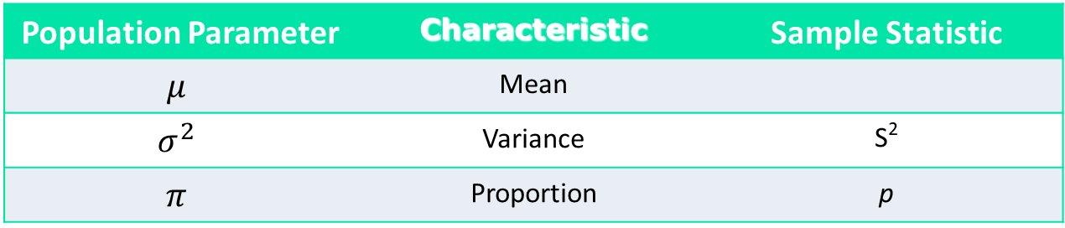
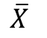
Sample statistics and population parameters
A sample statistic is a characteristic of the sample
Some sample statistics might be used as a point estimate for a population parameter
We use different notations to distinguish between the two groups of numbers
Population Parameter | Characteristic | Sample Statistic
$$μ$$ | Mean
$$σ^{2}$$ | Variance | S²
$$π$$ | Proportion | p
$$\overline{X}$$
Notes:
OK, lets take an example. Population is the entire class of PGP. Say the parameter of interest to me is average work experience. Now tell me how to proceed.
“Someone will say select X random students from this class and take the average.” This is what we call as a sample mean and it is a sample statistic. Now if someone really pushed me, then I would give this as an estimate of the population mean. We call this as a point estimate.
What do you think of this point estimate?
It is reasonably good. Imagine that I slowly increase the size of my sample, what should happen to the sample mean. It should get closer and closer to the population parameter. If my sample is the entire population, they should match. Not every statistic has this property. Think about choosing the maximum of the sample and calling it a point estimate of the population. If I take larger and larger samples, it will never come close to the mean. In fact, it will only keep increasing.
But as we had said before there are problems with point estimates too. In order to understand these, I would like to explore some properties of the sample statistic and lets start with sample mean because it is easiest to understand.
But before that, let me spend a few minutes talking about samples.
4

Slide 5
Exercise on Sampling

Slide 6
Selecting a Simple Random Sample (SRS)
Unbiased: Each unit has equal chance of being chosen in the sample
Independent: Selection of one unit has no influence on selection of other units
SRS is a gold standard against which all other samples are measured
Notes:
In this class, we will constantly use samples in our calculations. Let’s spend a few minutes to understand how to select samples and how not to.
Back to our example of work experience of Class of 2014. I can be very careful about choosing the sample. 70% are engineers, so I want 70% in my sample to be engineers. 50% have IT background, so 50% should be IT. 25% are women, etc. So on and so forth. Would this work? Why not? Too many dimensions and overlapping too. Also, many dimensions are not observable and you can never match on the basis of those.
So here is another extreme – don’t think too much about the sample selection. Just choose randomly from the population. Just keep in mind two things – equal chance of selecting every unit and independence. The first one is simple. What about the second one. Consider this, I select a random number between 1 and 8. Depending on which number comes, I choose the entire section as my sample. What is the chance of each individual to be picked in the sample 1/8th. If I told you that X is in the sample, what is the probability that Y is in the sample? Is it independent?
So this is not an SRS. Are there samples like this in practice? Yes, several of them! OK, we will come back to this later. But first how do I make this a SRS? Get a single list of all students in PGP and then randomize over it. So, now we see that we need two things – list and a randomization device. The list is called a sampling frame. In our simple example, this was the entire population but in many realistic cases, this is usually a subset of a population (go to board) and the key question becomes is this list representative of the population. Gallup poll vs. Literary Digest.
Now, let’s take another example –Quality of teaching in publicly schools in India. Suppose I want to get SRS. Where do I get the entire list of teachers to randomize over? Constructing this list itself is prohibitively expensive. So then, I need to do something that avoid this problem, which is a hierarchical approach. Another example is that of a project that I am currently doing for the Gates Foundation (we are looking at availability and use of ORS and Zinc in rural areas in UP and Bihar to treat diarrhea among under 5 children). Now the project itself is for only 3 months and if I decided to collect the list of all health care practitioners in the two states, three months would be over before starting any data collection. So I then again follow a hierarchical approach.
If my providers are informal, then there does not exist any list at all! Then, what do I do? Market research agencies who have done this several times in the past.
OK, now you have got the sampling frame, you have randomly chosen participants from it, and now you are trying to get a sample. Will everyone answer your questions? Providers who are busy are hard to find in their locations so I do not get their response!
6

Slide 7
Selecting the Sampling Frame
Sampling frame is simply a list of items from which to draw a sample
Does the sampling frame represent the population?
e.g. Literary Digest vs. George Gallup polls (Landon Vs. Roosevelt)
The available list may differ from desired list
e.g. we do not have list of customers who did not buy from a store
Sometimes, no comprehensive sampling frame exists
e.g. when forecasting for the future. Thus a comprehensive list of acceptances of credit card offers does not exist yet
Notes:
As you can imagine, randomizing when you have a list corresponding to the population is not that difficult. This can be easily done on a computer.
It turns out that the tricky part is before you randomize. This arises because sometimes I do not have the list of the entire population at my disposal.
Whatever list of items I have is called a sampling frame.
Suppose you wanted to find out the performance of your stocking policy in the supermarket. You could ask a random subset of customers at the check-out, did you find everything that you wanted? What’s wrong with that? Your sampling frame is the people who walked into the store and bought something. What about those who walked out because they could not find this one important thing and hence did not buy other things too?
The other issue is sometimes there is no sampling frame that is available. Suppose, I have a new diagnostic product to test for TB in coughing patients. I want to see if this product can be used by quacks in rural areas. What should I do?

Slide 8
Typical Pitfalls in Sampling
Collecting data only from volunteers (voluntary response sample)
e.g. online reviews (yelp.com, maps.google.com, tripadvisor.com)
Picking easily available respondents (convenience sample)
e.g. choosing to survey in In-Orbit mall
A high rate of non-response (more than 70%)
e.g. CEO / CIO surveys on some industry trends
Notes:
In many cases, there is no attempt at randomization by the virtue of the inherent design.
Think about all the reviews that you see online. My sense is that the customers have to have extreme experiences to be motivated to come and write reviews – either very satisfied or very dissatisfied. This is a case of voluntary sample.
Sometimes, even in research studies, subjects get some reward for returning the survey, even if it is probabilistic. You might have picked up people who are willing to take that incentive.
Here is a classic example. What happens when someone calls up people who are on the sample list but you do not get a response? Should you call them again or should you get more respondents?
OK, so from now on, in all our analysis, we are going to assume that the sample is a SRS and we can use it legitimately. Now back to our example on work experience of your class of 2014.
8

Slide 9
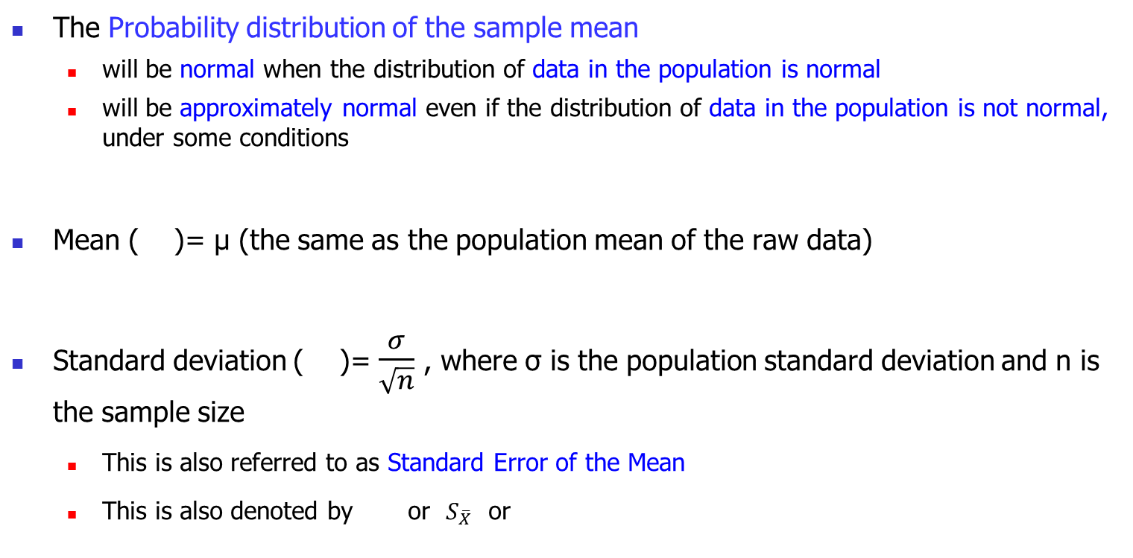
Central Limit Theorem (CLT) & the distribution of the sample mean
The Probability distribution of the sample mean
will be normal when the distribution of data in the population is normal
will be approximately normal even if the distribution of data in the population is not normal, under some conditions
Mean ( )= μ (the same as the population mean of the raw data)
Standard deviation ( )= $\frac{σ}{\sqrt{n}}$ , where σ is the population standard deviation and n is the sample size
This is also referred to as Standard Error of the Mean
This is also denoted by or $S_{\overline{X}}$ or
Notes:
This is one of the fundamental results of statistics and it has immense practical value. Almost the entire methodology that we are going to develop in this course, all software programs use this theorem on a routine basis. It says that the distribution of the sample mean is normal if the data is normally distributed. But even if the data is not normally distributed but you take a large enough sample and samples are drawn independently, the sample mean distribution is approximately normal. It also tells us that the mean of this distribution of sample means is the population mean and the standard deviation is population standard deviation divided by square root of the sample size.
This makes sense. When we take a sample and average over it, we are reducing the variability. I pick 10 people at random, I get some with more work experience and some with less, so that it is less variable than the population itself. Obviously if the sample size went very large, i.e., you were drawing the entire population, then there will be no standard error. You will know the population mean for sure.

Slide 10
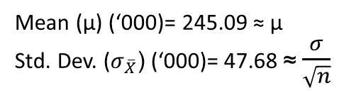
Be careful… Tale of two distributions!
Crime Dataset
The distribution of the data itself (Total Crime, N=1899), which may or may not be normal
Mean (μ) (‘000)= 245.2
Std. Dev. (σ) (‘000)= 303.7
Launch Poll 1
The distribution of sample means (10,000 samples, n=41), which is approximately normal due to CLT as long as the sample is “large enough”
Mean (μ) (‘000)= 245.09 ≈ μ
Std. Dev. ($σ_{\overline{X}}$) (‘000)= 47.68 ≈$\frac{σ}{\sqrt{n}}$
Notes:
Let me just emphasize that we are dealing with two distributions here. One is the population distribution, the other is that of the sample means.
“Draw the picture of two distributions.”
One might or might not be normal, the other is approximately normal.

Slide 11
CLT is Valid When…
Each data point in the sample is independent of the other
The sample size is large enough
A sample size of 30 is usually considered large enough but there are more precise conditions
n > 10 (K₃)², where K₃ is sample skewness, and
n > 10 |K₄|, where K₄ is sample kurtosis
Adequate sample size depends on the distribution of data – primarily its symmetry and presence of outliers
If data is quite symmetric and has few outliers, even smaller samples are fine. Otherwise, we need larger samples
Notes:
Of course Central Limit Theorem Is not like speed of light or gravitational constant. It is true under certain conditions.
The first one requires that the samples be drawn independently. The second one requires that the sample size is large enough and I will tell you what is meant by that.

Slide 12
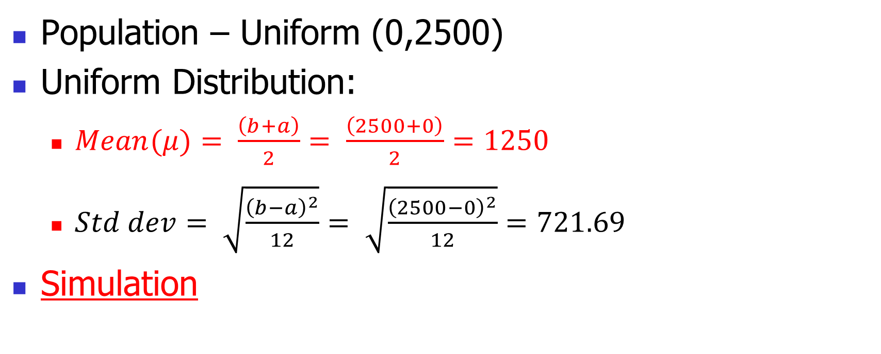
Simulation of CLT
Population – Uniform (0,2500)
Uniform Distribution:
$Mean(μ)= \frac{\left(b+a\right)}{2}= \frac{\left(2500+0\right)}{2}=1250$
$Std dev= \sqrt{\frac{{\left(b−a\right)}^{2}}{12}}= \sqrt{\frac{{\left(2500−0\right)}^{2}}{12}}=721.69$
Simulation

Slide 13
Questions?

